Slide 1


Course: Server Side Scripting - Team A
MVC | SOLID | DRY | SECURE
Hayden McLaren
Glen McNeur
Jack Eaton
David Mullan
Cainton Milroy

Slide 2
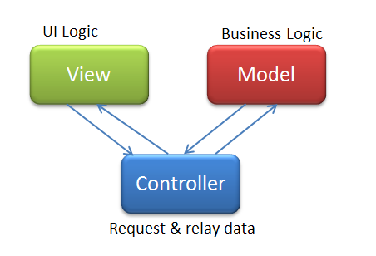
MVC and FEC

Slide 3
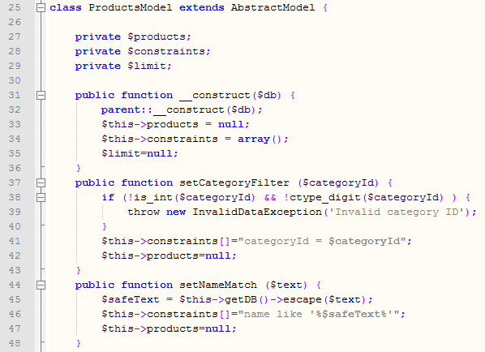
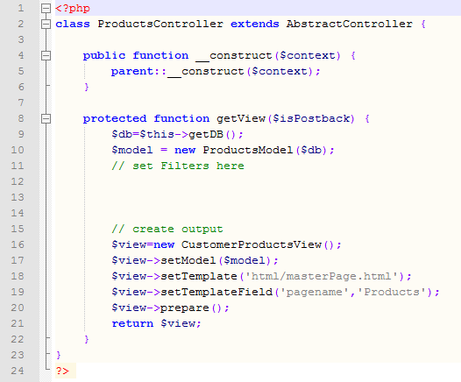
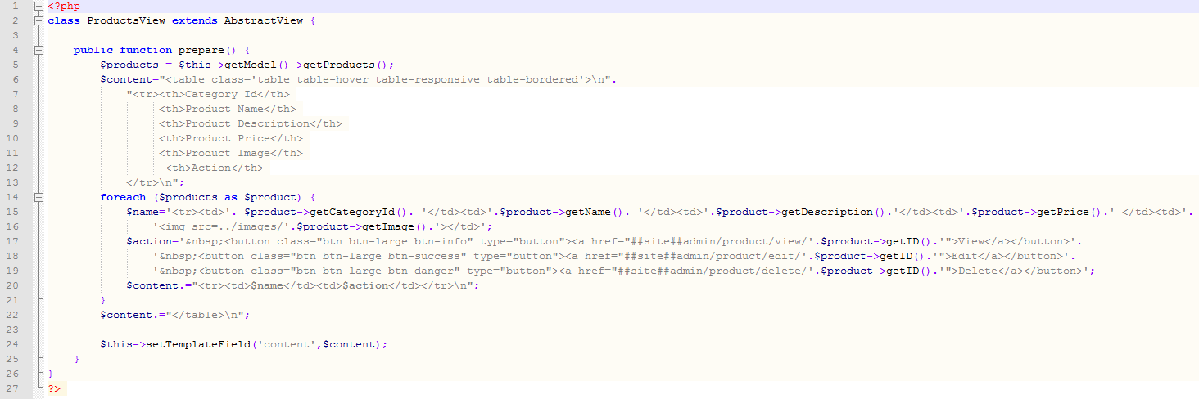

Slide 4
SOLID
Single responsibility
Open/closed
Liskov substitution
Interface segregation
Dependency inversion
DRY
Don’t Repeat Yourself
SoC
Separation of Concerns

Slide 5
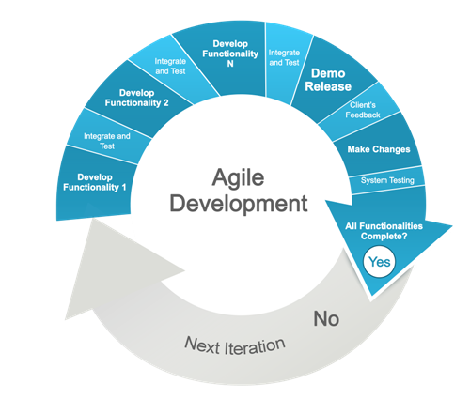
AGILE

Slide 6
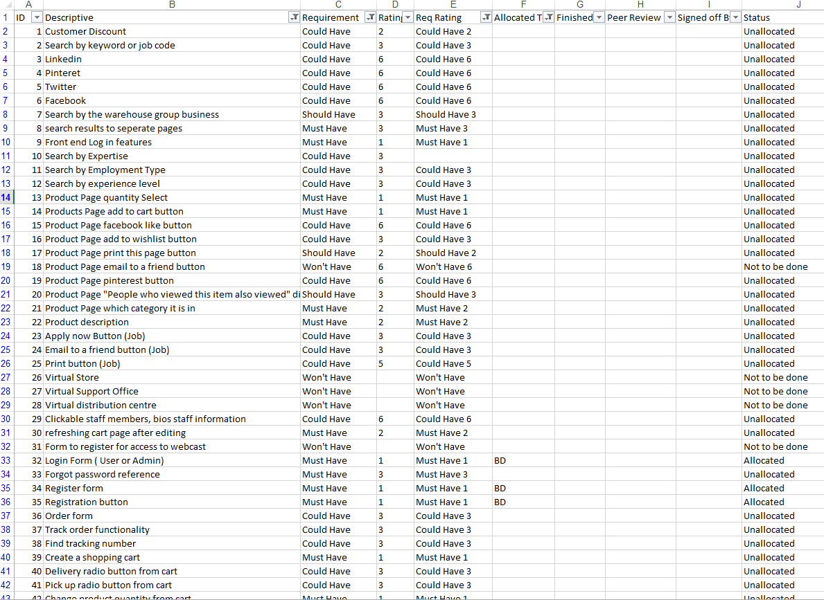

Slide 7
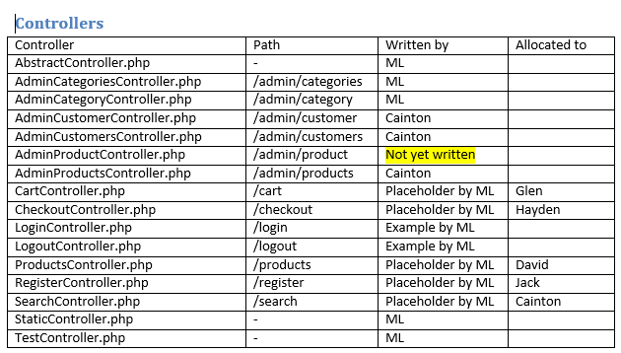
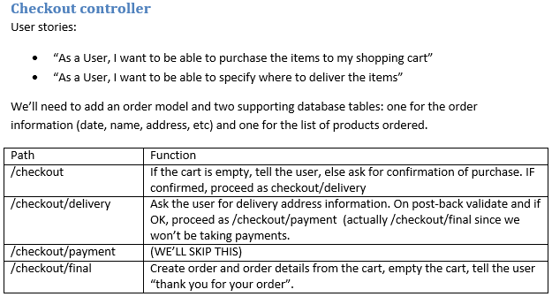
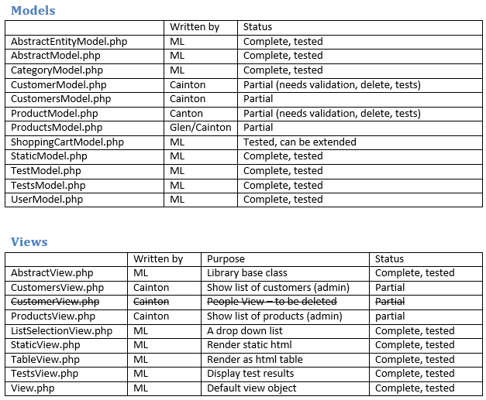

Slide 8

Collaboration

Slide 9
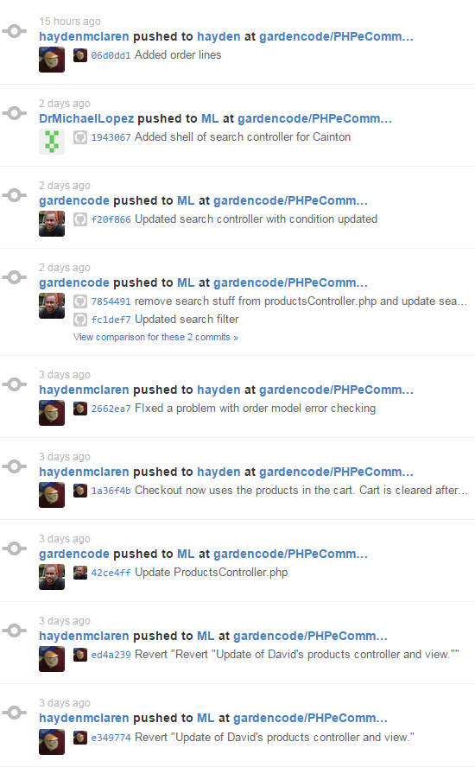
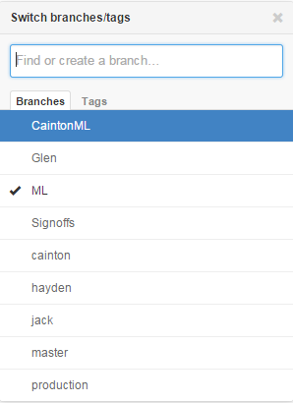

Slide 10

LESSONS LEARNT & MOVING FORWARD
See word doc

Slide 11
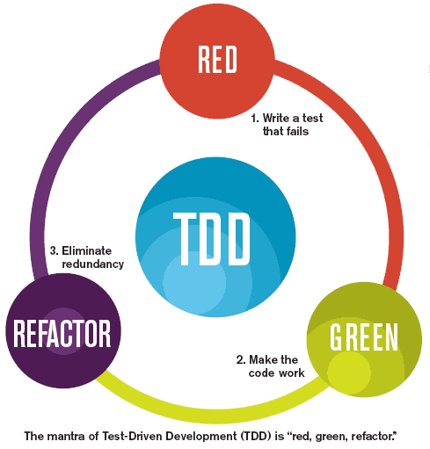


Quality Assurance
See word doc

